Slide 1

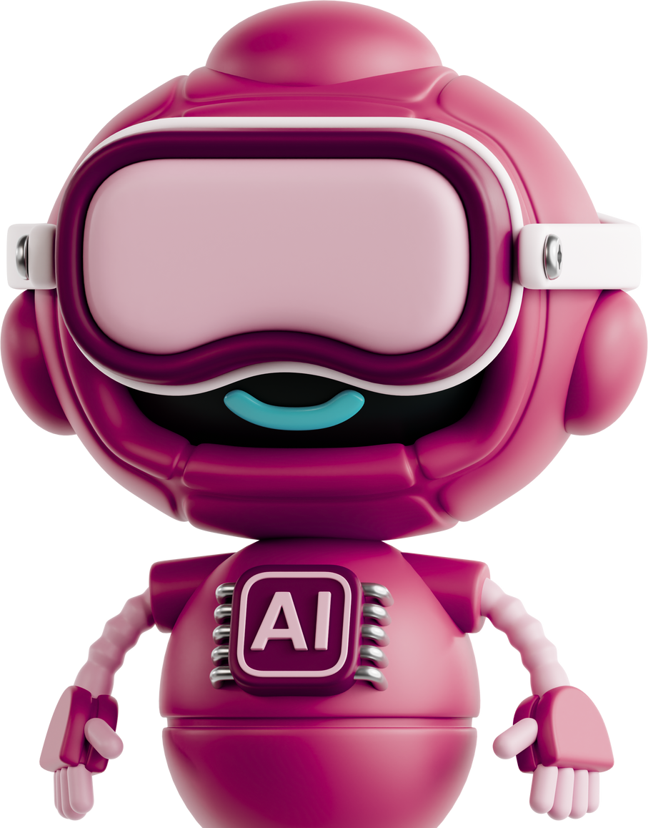
Conversational AI
Calling Agent
24/7 Available
Appointment Booking
Mongodb Integration

Slide 2
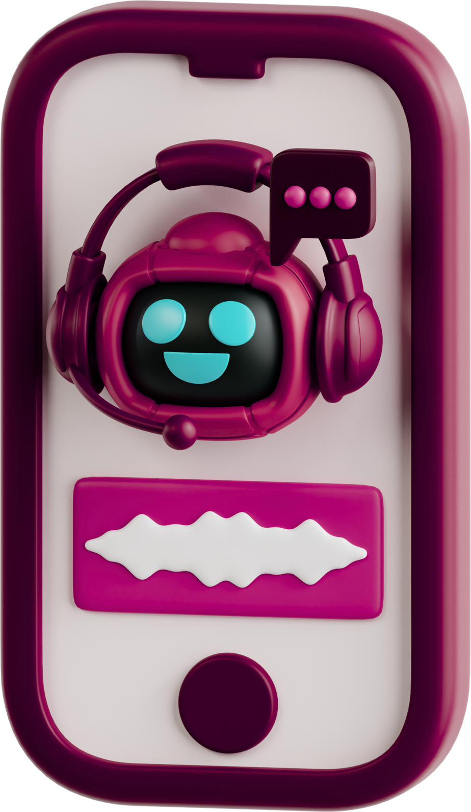

Problem
24/7 Automated Customer Support
Reduce Operational Expenses
Rapid and Precise Responses
Easily Integrates with Your Business Systems

Slide 3
Solution
Automation
Immediate Reply
understands queries
Instantly books appointments
API Integration
Connect with CRM, Email, WhatsApp, etc.
Confirms Appointment
Multilingual Support
cancels appointments
Serving International Clients

Slide 4




How it
Works
Speech Recognition + NLP → Understands human voice
Telephony Integration → Manages real-time calls
Backend System → Updates and tracks appointments automatically

Slide 5

Key Feature’s
Real-Time Multi-Call Handling
Handles multiple live calls at the same time without any lag.
Natural Voice Interaction
Understands and responds just like a human conversation.
AI-Powered Understanding
Uses advanced NLP to interpret user intent and provide accurate responses.
Instant Appointment Booking
Books, confirms, or cancels appointments instantly through voice commands.
Secure & Reliable System
All call and appointment data is processed safely with complete confidentiality.
24/7 Availability
Always active — no waiting, no office hours limit.

Slide 6



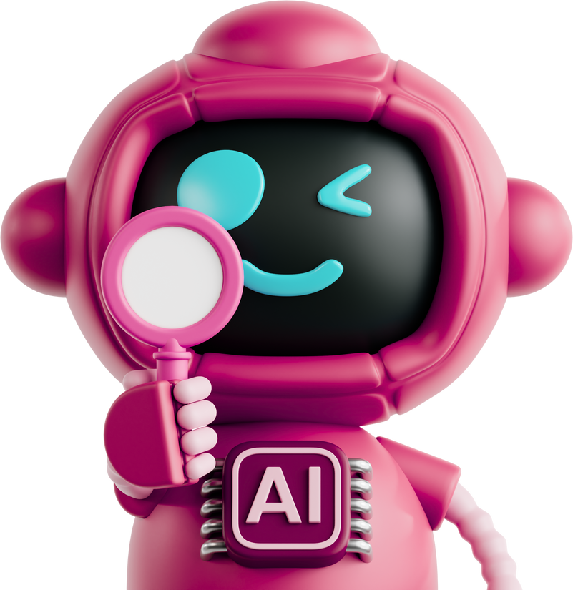
Create Your AI Voice Agent Today!
This AI Callbot saves time, reduces workload, and improves patient experience.
It’s a step forward toward smart, voice-driven healthcare automation.
Schedule a Complimentary Demonstration Today!

